Slide 1
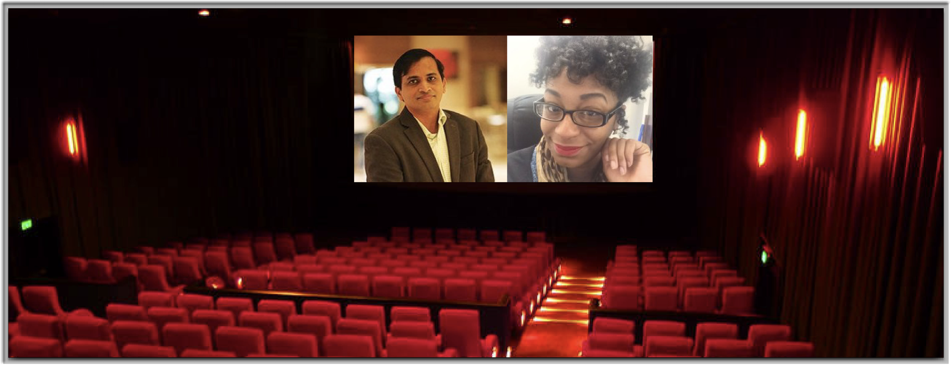
Mini Project 1 - The Filmmakers
Presented by Jason OHara

Slide 2

Stakeholder Problem
First Feature Film
Priorities:
Attract Potential Investors
Appeal to Wide Audience
Make Money
Question:
What Genre Would Be the ‘Safest’ To Pursue?

Slide 3
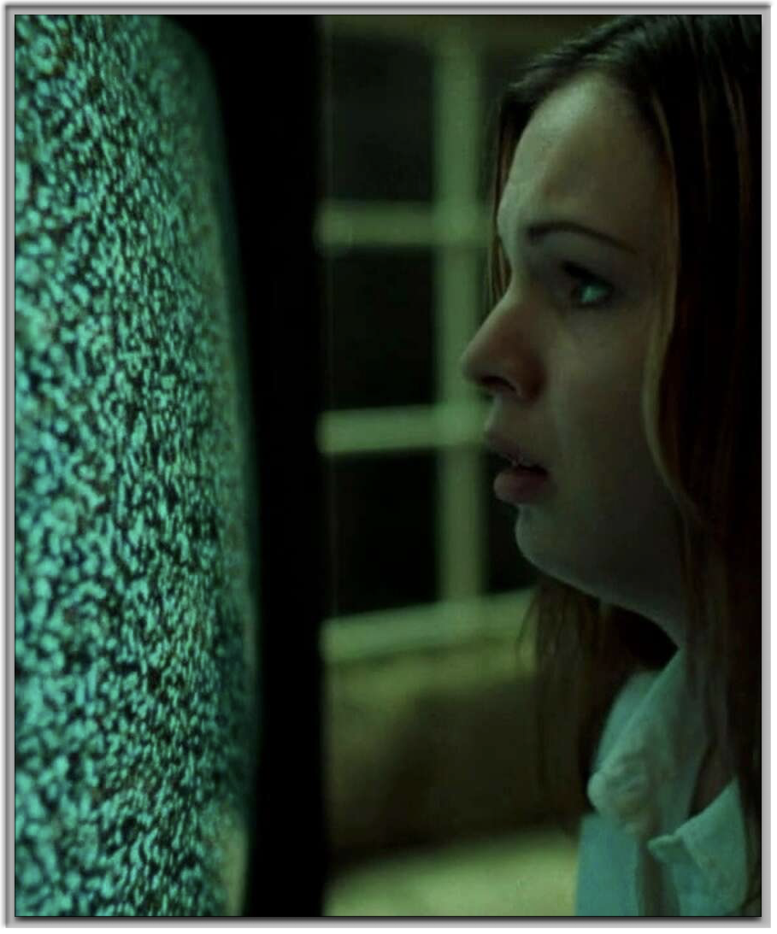
Data Science Problem
Film Ratings as Predictor
Used as Investor Benchmark
Moviegoer Uses, Too
Is It a SMART Goal?
Yes.
We Agreed to Keep It Simple

Slide 4


Slide 5
Summary of Data Used
kaggle.com IMDb Top 1000 Films Dataset, csv
Top 3 Sites - Rotten Tomatoes, Letterboxd, IMDb
IMDb = Zero cost through Kaggle
Right-sized & easy to work with
wikipedia.org Unesco Institute for Statistics - Average Ticket Price
Assumptions - US prices only; Where null, averaged between prior year and year following; Where null at start or end of data, used % increase/decrease for year(s) prior

Slide 6

Data Wrangling

Slide 7
Data Wrangling Process
For the KAGGLE Dataset:
Converted to Pandas DataFrame
Isolated main_genre
Dropped unnecessary columns and null-value rows
Retained columns needed for analysis
Nulls were in the 16% (‘Meta_score’) and 17% (‘Gross’) range, respectively. Typically too high to drop.
Opted to replace ‘Meta_score’ nulls with mean and drop the ‘Gross’ nulls. Predictive Imputation for ‘Gross’ in the Future?

Slide 8
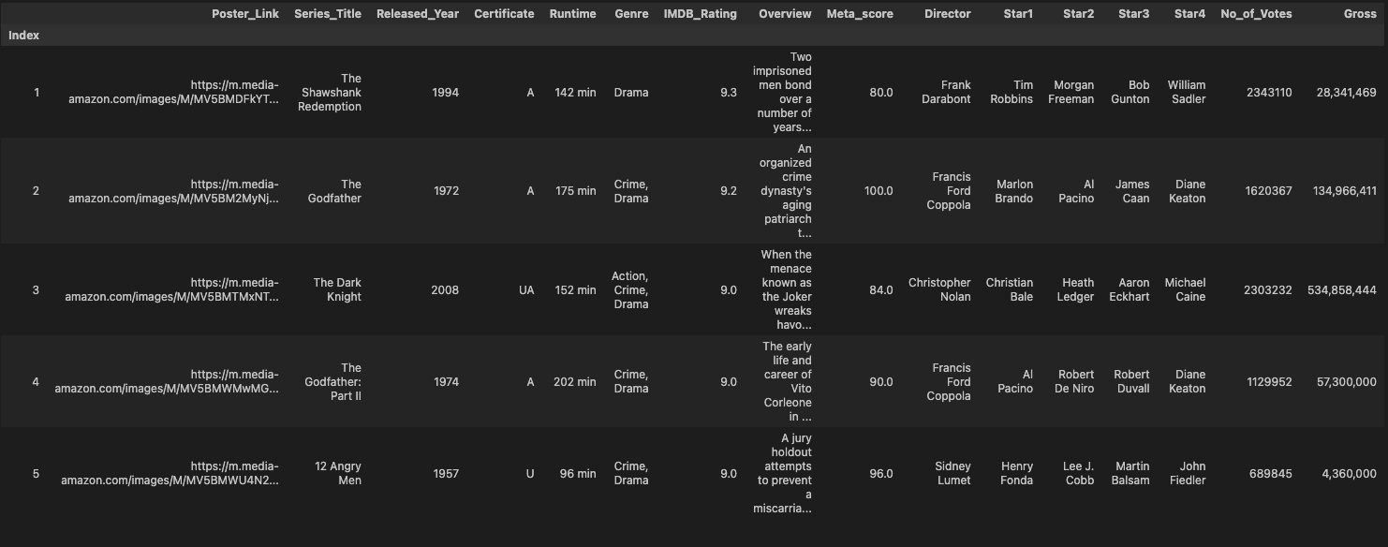
Dataset Before

Slide 9
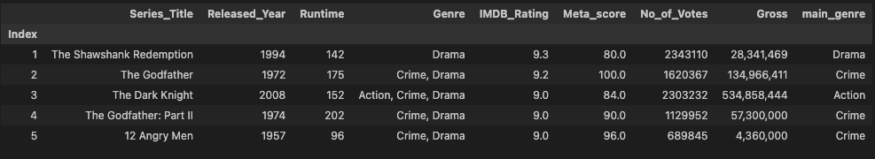
Dataset After
Replaced
Nulls w/ Mean
Dropped
Nulls
New

Slide 10
Data Wrangling Process
For the UNESCO Dataset:
Converted to Pandas DataFrame
Assumptions made before importing data
Used US average ticket sale price only

Slide 11
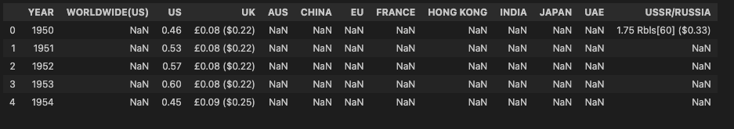
Dataset Before

Slide 12
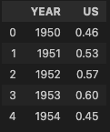
Dataset After
Merging
Avg Ticket
Sale Price
Using Year
As Reference

Slide 13

Feature Engineering

Slide 14
Feature Engineering Process
Used ‘Year’ to merge Unesco Dataset into the Kaggle Dataset
Created new column to determine value for # of tickets sold
Used tickets_sold to help determine which genres would be the most-likely to make money

Slide 15
Feature Engineering Process
Using the Mean, looked for comparisons between ‘Main_Genre’ and the following:
IMDb_Rating
Meta_Score
Tickets_Sold
No_of_Votes
** Using the median to account for outliers did not significantly change the outcome**

Slide 16
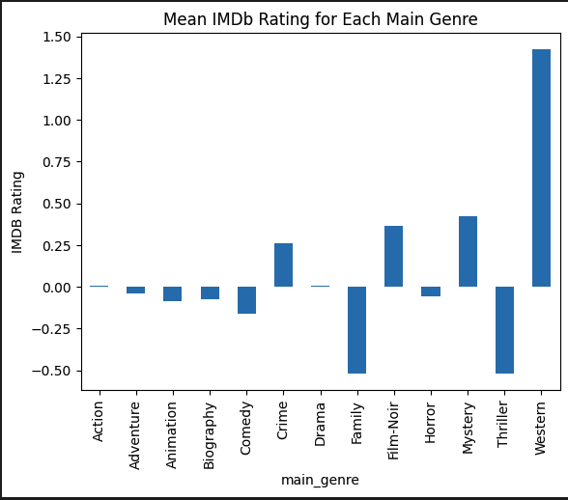
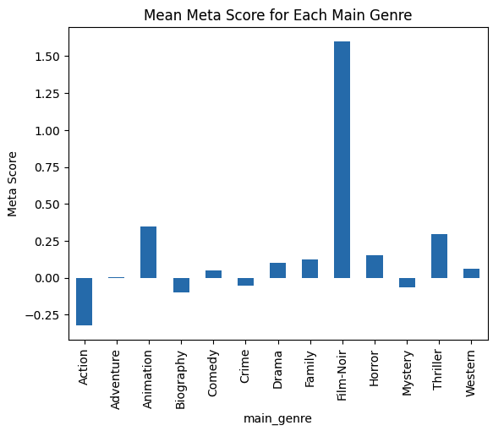
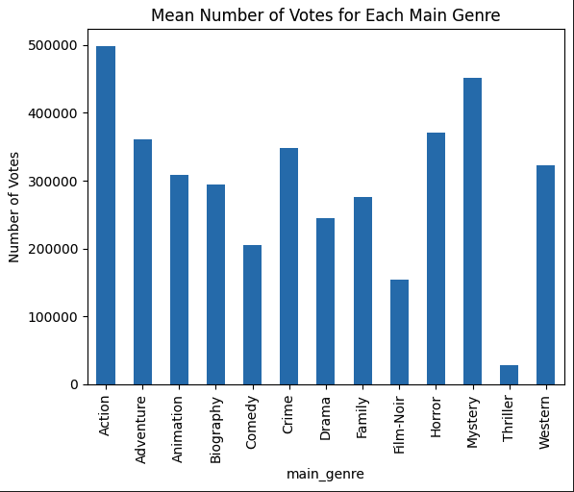
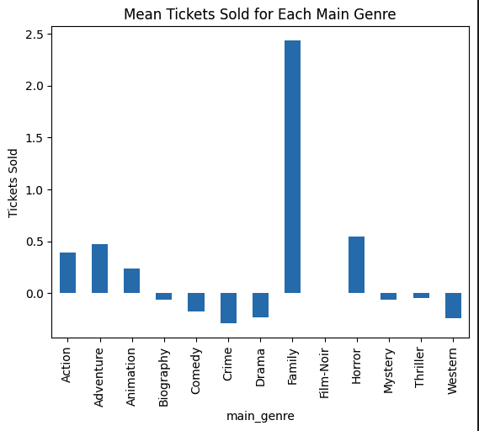
IMDb = Western
Meta Scr = Film-Noir
Votes = Action
Tickets = Family

Slide 17
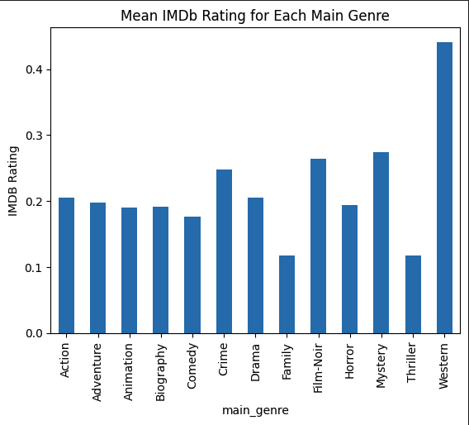
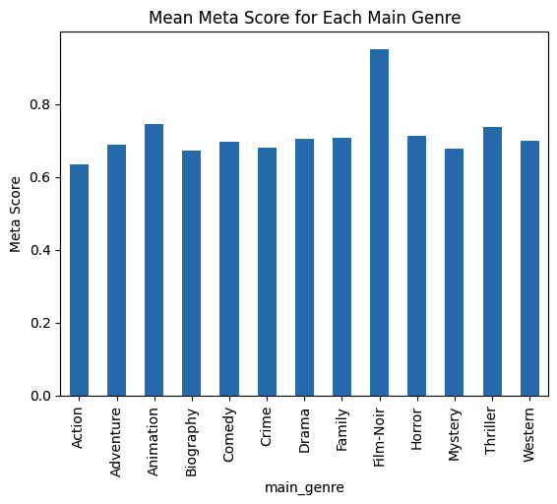
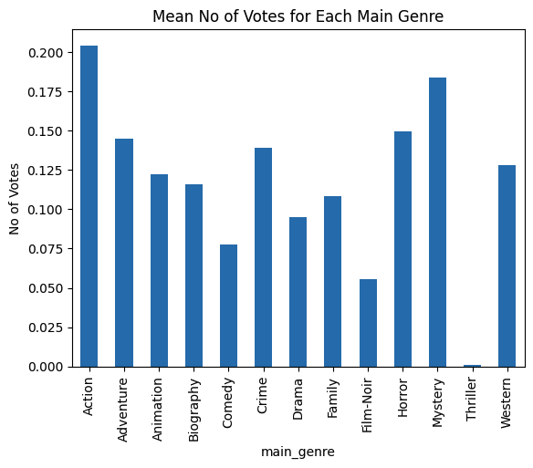
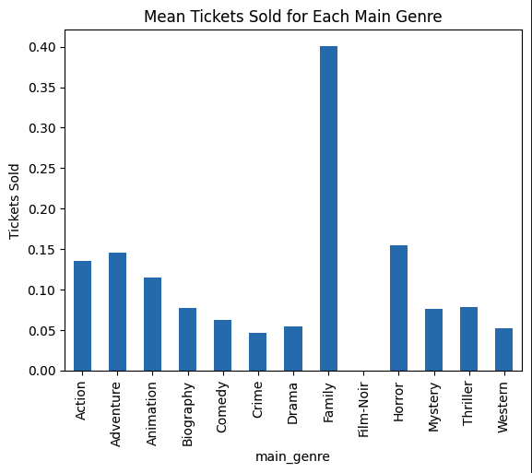
IMDb = Western
Meta Scr = Film-Noir
Votes = Action
Tickets = Family

Slide 18

Summary & Next Steps

Slide 19

Best Bet for Positive Reviews
A Neo Western
Combines the best of both IMDb & Meta Score
Avoid Action, Family & Thrillers

Slide 20

Best Bet to Make Money
A Family Film
Higher Number of Tickets Sold = More Opportunity to Make Money
Avoid Comedy, Crime, Drama & Westerns

Slide 21

Best Bet to Create Buzz
An Action Film
Most Reviewed = Most Vocal (All Press is Good Press)
Avoid Thrillers

Slide 22
Next Steps / Lessons Learned
Expand Dataset
Not a big enough range
These are the “Top” 1000, so data is already skewed
Explore Using Machine Learning
Better results for this type of exploration
Would provide more probabilistic outcomes vs stopping at EDA
Goal would be to achieve a “score” for each genre, based on a combination of the features:
IMDb Rating
Meta Score
Tickets Sold
Gross Sales (Accounting for Inflation)
Number of Reviews
Don’t Mess Around Too Much!
Altering the Dataframe too much down the line can mess you up!

Slide 23


